Slide 1
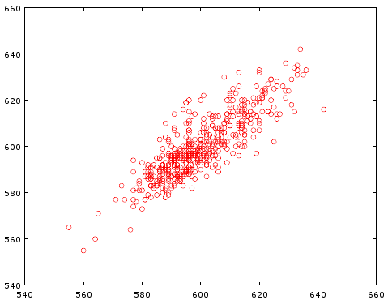
RR (i+1)-th (ms)
RR i-th (ms)

